Slide 1
New Mexico 4-H 101
Part 4

Slide 2
A 4-H Leader’s Role
Organizer, facilitator, teacher and mentor.
Create educational programming through club meetings, community service projects, events, activities,
Give of their time and resources to help youth learn and gain skills,
All the while having fun in the process!
Notes:
Script notes:
Volunteer adult 4-H Leaders are organizers, facilitators, teachers and mentors to the youth in the 4-H program.
Leaders work with Extension professionals to create educational programming through club meetings, community service projects, events, activities, and different types of learning by doing experiences.
Leaders give of their time and resources to help youth learn and gain skills they will use throughout their lifetime,
All the while having fun in the process!

Slide 3
A 4-H Leader’s Role
Conduct Youth Development Programs
Policies and procedures under which New Mexico Cooperative Extension operates.
Non-discriminatory, and are available to anyone regardless of
Race,
National Origin,
Religion,
Disability,
Marital Status
Color,
Gender,
Age,
Sexual orientation
Further information is available in the Policies & Procedures Handbook at http://nm4h.nmsu.edu.
Notes:
Script notes:
As a volunteer leader, you occupy an important position of conducting youth development programs
Consistent with policies and procedures under which New Mexico Cooperative Extension operates.
Programs for 4-H members and 4-H leaders are non-discriminatory, and are available to anyone regardless of race, color, national origin, gender, religion, age, disability, sexual orientation, or marital status. Further information is available in the Policies & Procedures Handbook at http://nm4h.nmsu.edu.
All 4-H leaders in New Mexico serve on a volunteer basis. To serve as a leader is a responsibility as well as an honor. The New Mexico 4-H Youth Development Program believes in providing a safe environment for youth to learn and achieve. (NM 4-H Club Leader Handbook)

Slide 4
NM 4-H Club Leader Handbook
All 4-H leaders in New Mexico serve on a volunteer basis. To serve as a leader is a responsibility as well as an honor. The New Mexico 4-H Youth Development Program believes in providing a safe environment for youth to learn and achieve.

Slide 5
Steps to become a 4-H Leader
Contact your County Extension Office
Complete Application and Background Check
Complete 4-H Working with Minors Training
Receive approval from County Extension Office

Slide 6
Building a team The team approach:
Assures that 4-H belongs to everybody in the club.
Opportunity for each person to grow as the work of the club is shared.
Prevents burn out and fade out
Prevents martyrs who do all the work but complain about doing it.
Notes:
Script notes:
Building a Team
The team approach to leadership and program development assures that 4-H belongs to every- body in the club.
Involving each person also assures opportunity for each person to grow as the work of the club is shared.
If 4-H leaders don’t approach club leadership as shared leadership, they can burn out, fade out,
Or become martyrs who do all the work but complain about doing it.

Slide 7
Building a Team
4-H officers
Junior and
teen leaders
Adult leaders
Parents
Youth learn to take charge of their group. Adult leaders guide and facilitate; they maintain the club structures, which make learning possible, and provide leadership experiences for youth.
Notes:
Script notes:
Building a Team
Your 4-H club team is composed of youth and adults:
4-H officers,
Junior/teen leaders,
Adult leaders, and
Parents.
Youth learn to take charge of their group. Adult leaders guide and facilitate; they maintain the club structures, which make learning possible, and provide leadership experiences for youth.

Slide 8
Types of 4-H Leaders
To form an effective team, you must define the types of leaders your club needs.
This will depend on the size, type of club, and the ages of the members
Club Officers
President
Vice President
Secretary
Treasurer
Reporter
Adult Leaders
Organizational leader
Project leaders
Additional Leaders
Assistant Leaders
Activity Leaders
Junior or Teen Leaders
Notes:
Script notes:
Types of 4-H Leaders
To form an effective team, you must define the types of leaders your club needs. This will depend on the size, type of club, and the ages of the members.
Minimally, clubs have officers
President,
Vice president,
Secretary,
Treasurer, and
Reporter
Adult leaders
Organizational leader
Project leaders
Some clubs have assistant leaders, activity leaders, and junior or teen leaders.

Slide 9
Experience a positive self-concept
Experience success
Basic Needs of Youth
Become increasingly independent
Develop and accept ones own identity

Slide 10
Ages and Stages Overview
Satisfaction from participation in 4-H is based on matching the level of involvement to the needs and readiness of the youth. Each individual matures at his or her own pace and the transition from one state of development to the next is gradual. Understanding characteristics and needs at different developmental stages is important in planning 4-H learning opportunities. This promotes progressive acquisition of subject matter information and life skills.
The following presents general developmental characteristics of youth at various ages. Activities and projects should be developed in recognition of needs at various life stages.
Developmental Characteristics of Youth and Implications for Experiential Learning
Resource: Developmental Characteristics of Youth: Implications for Experiential Learning http:// www.experientiallearning.ucdavis.edu/tlbx-ages.shtml

Slide 11
Characteristics
Implications
Apply
Reflection/Share
Ages 5-8
Notes:
Characteristics
Easily motivated, eager to explore and try new things
Learn best if physically active Short attention span, deal with here and now Sensitive to criticism, do not accept failure well
Strong desire for affection and attention of adults
Reflect/Share
Consider alternative ways of expressing things learned during activities such as writing stories, drawing pictures, and other creative outlets
Ask learners to talk about the activities – were they fun, boring, easy, hard, new, done before
If a sequential process was used, have learners name the steps completed in the process
If problems happened in the activities, ask learners why they occurred and what could
have been done differently to avoid them next time
If supplies were used in doing activities, ask learners what other supplies they could use when doing the activity again
Implications for Experimential Learning Experience
Give clear and specific instructions Plan a variety of activities where success can be experienced Reading to this group is effective and enjoyed Plan activities that take a short time to complete and build on previous experiences
Focus on the “doing” rather than the finished products
Apply
Ask learners to tell you what they will tell their family or friends about the activities they have just completed
If activities relate to careers, help learners to make those connections through pictures, stories from family members, sharing of memories, role-plays, field trips, etc.
Have learners work with family members on follow-up related activities

Slide 12
Characteristics
Implications
Apply
Reflection/Share
Ages
9-11
Notes:
Characteristics
Very active with lots of energy
Easily motivated and eager to explore and try new things
Extremely curious - constantly ask “why?” Enjoy hands-on activities
Like being in groups of same sex
Learn about self through relationships with others
Admire and imitate older boys and girls
Rapidly changing interests
Usually do best when work is laid out in small pieces
Guidance from adults is important for staying on task
Do not see value in keeping records
Think more of the “here and now” present and not looking to the future
Like symbols and ceremony
Need recognition and praise for doing good work
Implications for Experiential Learning Experience
Allow groups to develop parts of a larger plan
Use hands-on, learn-by-doing activities
Use activities where learners need to determine and find needed resources Build in activities where learners share/exchange resources
Plan activities that allow learners to physically move about
Emphasize group learning experiences
Use activities where learners achieve and produce a product
Keep written work simple – review forms and worksheets with the group step-by-step
Give clear instructions with set deadlines
Clarify and enforce reasonable limits and boundaries
Involve older teens in helping the group to plan and carry out activities together
Encourage group free time
Be visible and accessible but in the background
Present recognition in front of peers and parents
Apply
Have learners generate alternative solutions to problems solved in the activities, or speculate other problems that could be solved in similar ways
Build in ways parents, teachers, and other adults can help learners complete follow-up additional activities
Provide opportunities to set two or three goals for a six-month period
Work with learners to identify and study related careers
Build in community service roles to reinforce content taught
Reflect/Share
Have learners share what interests, talents, abilities, and skills they developed in the activities
Ask learners to share any modifications they made during the activities
Ask learners how teamwork, cooperation, friendship, and sportsmanship played out in activities completed
Ask learners to verbalize or demonstrate opposing points of view they observed in the activities
Plan group time to talk about beliefs and values as related to activities completed
Ask learners to demonstrate the steps completed in the activities
Ask learners what questions they still have about the activities just completed. Encourage them to find some of the answers on their own, or encourage a few learners to find the answers and report back to the group
Have learners explain rationale for choosing some options over other ones in the completed activities
Help learners identify successes achieved in the activities –give positive feedback to the efforts and successes you see (and look for them!)
Provide correction quietly, one-on-one, in a caring and consistent manner
Avoid generalized praise – this group sees through it and feels manipulated

Slide 13
Characteristics
Implications
Apply
Reflection/Share
Ages
12-14
Notes:
Characteristic
Concerned about physical development, self-conscious
Want to be liked by friends
Interested in activities involving boys and girls together
Interested in sports and active games
Like fan clubs, many have teen or adult idols
Getting over the age of fantasy, beginning to think of what they will do when they grow up
Often unclear of needs and values
Desire independence but want and need their parents’ help
Want to explore outside of their own community
Reflect/Share
Ask learners to reflect on what they learned in the activities
Ask learners about their observations in working as a group, and what they may have observed about other groups
Have learners prepare and give presentations on what they gained from or thought of the activities completed
Ask learners to define their leadership style based on their performance in the activities completed
Apply
Provide opportunities for learners to ask and question ways of doing things in the group
Present similar scenarios, and ask learners to predict results
Find time to talk with them individually
Have learners keep a journal of personal or their project related experiences
Encourage technological application of key concepts
Help learners identify and perform personal and group contributions that meet community needs
Relate activities completed to career choices
Have learners shadow experienced workers in related fields
Implications for Experiential Learning Experience
Encourage learning experiences related to understanding self and getting along with others
Encourage active and fun learning experiences
Encourage learning experiences involving boys and girls
Provide hands-on and skill-centered experiences in specific subject matter
Give learners a chance to choose when and if to be in a position where they stand out from the group
Allow opportunities for quiet time
Tasks can be more difficult and of longer duration – making a model, keeping a journal – allow for creativity
During activities, ask questions to encourage predicting and problem solving such as “What if this doesn’t work? What could happen then?”
Help learners find necessary information and resources
Encourage working with older teens and adults to complete learning experiences
Teen leaders should be three or four years older than the learners and considerably more mature
Provide opportunities to practice leadership roles with coaching, and encourage keeping more detailed records of leadership experiences
Encourage involvement in teen councils and planning boards
Involve the group in setting rules
Provide realistic parameters – explain why they are necessary
Avoid singling learners out in front of others either to commend or to criticize
Provide learning experiences outside of the community

Slide 14
Characteristics
Implications
Apply
Reflection/Share
Ages
15-19
Notes:
Characteristics
Like being in groups of boys and girls
Want and need a strong voice in planning programs
Want adult leadership roles
Beginning to think about the future
Often need guidance in selecting careers
Becoming more aware of the community and how they can be involved
Implications for Experiential Learning Experience
Provide opportunities for self-expression and leadership
Provide activities to interact with the opposite gender such as trips, dances, work groups
Provide opportunities for learners to talk about their own beliefs, ideas, and abstract concepts
Involve learners in carrying out plans – they are ready to be creative and ready to take responsibility for affecting change
Plan activities where learners can experiment with different roles
Encourage greater in-depth study of leadership roles and life skills
Involve learners in more direct developmental activities such as tutoring, coaching, leading groups, speaking to community groups, mentoring younger children
Be willing to admit mistakes as an adult!
Apply
Ask learners to identify skills used in their group that are also needed in the workplace
Ask learners how they contribute to the well being of their families in similar ways to their participation in this group
Challenge learners to find answers to similar problems
Encourage application of leadership life skills to living on their own – incorporate budgeting and money management applications
Construct experiences that involve them with the larger society
Support learners as they design follow-up related independent learning experiences
Ask learners to develop plans for future life transitions
Encourage them to participate in career, college, vocational days
Encourage learning activities involving the community
Organize experiences outside of their own community
Reflect/Share
Ask learners what new information they learned in the activities
Challenge learners to interpret and creatively communicate learning
Ask learners to summarize how the group made decisions together throughout the activities
Ask learners how the activities could have been structured differently to more efficiently accomplish the same goals
Ask learners to describe or demonstrate how they compensated for unexpected challenges and changes in the activities
Ask learners to detail resources needed (available and missing) to complete the activities
Ask learners to generate and evaluate additional alternatives to activities
Ask learners to describe underlying rules, values or principles in the activities, and how they influenced the results

Slide 15
The 4-H Project
The 4-H Project
Focused area of work
Planned sequence
research-based learning opportunities
Skill and positive youth development
The Project Group
Guidance of a volunteer 4-H project leader
4-H Community Club
One common project
Horse
Photography,
Sewing
Shooting sports.
Result
Knowledge
Skills
The Project Curriculum
Project Choices
Wide range of
Learning experiences
Hands-on,
Research-based.
Curriculum Materials
Support and guide learning
Support individual learning
Challenge members
age-appropriate and
Notes:
Script notes:
The 4-H Project
4-H projects provide a focused area of work that a member decides to enroll in each year. A project is a planned sequence of age-appropriate and research-based learning opportunities leading to skill development and positive youth development outcomes.
Several members working in the same subject matter area become a project group under the guidance of a volunteer 4-H project leader. A 4-H community club can include several project groups. In other instances, a project club may be formed around one common project interest – such as horse, photography, sewing, or shooting sports. As a result of long-term active engagement in the 4-H project, the youth gains knowledge and develops skills based on planned goals and identified outcomes.
4-H offers a wide range of project choices – all designed to give members that extra edge for life success through hands-on, research-based learning experiences. Our goal is to ensure that every 4-H member and leader has research-based curriculum materials in hand to support and guide their learning in each 4-H project in which they enroll. Project materials are the curriculum to support individual learning and challenge members to achieve their goals. Project manuals are like the textbooks for 4-H.

Slide 16
State Approved 4-H Projects
County Projects
Self Determined Projects
Supported by the New Mexico 4-H Youth Development program.
Listed in New Mexico 4-H Projects and Literature
Coordinated through your County Extension Office.
Developed and used at the county level
Not listed in the state publications catalog
Usually set up to meet a specific need within the county 4-H program
Check with your Agent for county 4-H project opportunities available in your county
Designed for the 4-H member who is interested in the further study of a subject for which no additional 4-H project materials are available.
May be a continuation of a regular 4-H project
Educational goals for self determined projects should be approved by the 4-H leader before beginning the project.

Slide 17
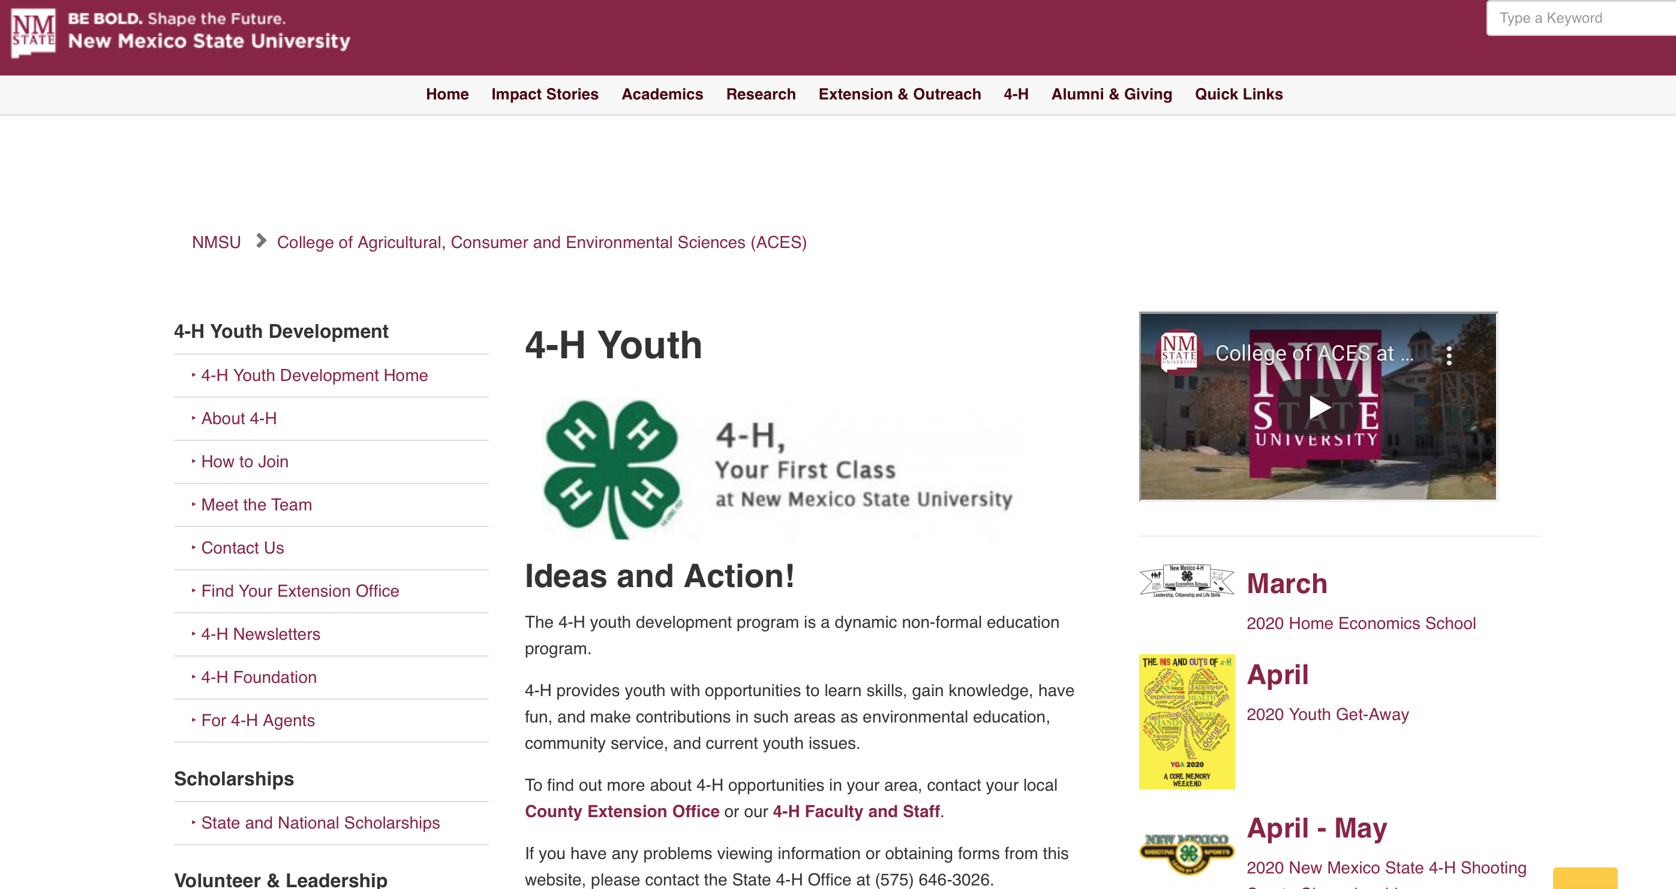
For more information about 4-H in your county go to the New Mexico 4-H website. The menu on the left side of that page has a Find Your Extension Office tab.

