Slide 1
New Mexico 4-H 101
Part 2

Slide 2
Family and community centered
Responsive to change
Volunteer led
What is 4-H?
Publicly and privately funded
Extension staff supervised
Research based

Slide 3
New Mexico 4-H Youth Development Program is the youth development program of the
New Mexico State University
Cooperative Extension Service.
The mission is to provide youth the opportunities to acquire leadership, citizenship, and life skills. New Mexico 4-H programs are based on the four concepts of positive youth development which are belonging, mastery, independence, and generosity.

Slide 4
County Extension Office
County Program Director
County Extension Agent
Programs
4-H
Ag
FCS
Others
Program areas include 4-H Youth Development, Agriculture and Natural Resources, Family and Consumer Sciences and many other programs to improve the quality of life.

Slide 5
County 4-H Program
Inform 4-H clientele regarding projects
Assure 4-H programs provide educational opportunity
Develop volunteer 4-H leadership
Conduct 4-H adult volunteer leader screening
Extension Agents are Responsible for:
Notes:
Script notes:
Extension Agents are responsible for:
County 4-H program planning, implementation and evaluation;
Informing 4-H clientele regarding projects, programs, opportunities and policies of the New Mexico State University Cooperative Extension Service Youth Development programs;
Assuring that the 4-H program provides educational opportunities to assist in the youth development process;
Developing the volunteer 4-H leadership necessary to conduct 4-H events and activities at the local club and county levels;
Conducting 4-H adult volunteer leader screening;

Slide 6
Secure, manage and account for resources
Serve as an advisor
Extension Agents are Responsible for:
Coordinate program efforts, interpret policies and serve as a representative of the New Mexico Cooperative Extension Service
Insure that all 4-H programs and activities follow Title VI of the Civil Rights Act, Title IX of the education Amendment of 1972 and Title II of the Americans with Disabilities Act of 1990
Matters of conduct, discipline, health and safety
Notes:
Script notes:
Extension Agents are Responsible for
Securing, managing and accounting for the resources needed to conduct effective educational 4-H programs;
Coordinating program efforts, interpreting policies and serving as a representative of the New Mexico Cooperative Extension Service;
Serving as an advisor to county 4-H clubs, committees, councils and associations;
Has final authority in matters of conduct, discipline, health and safety in connection with 4-H members and leaders attending 4-H events and activities located in the county, state, or outside of the state; and
Insure that all 4-H programs and activities are within the provisions of Title VI of the Civil Rights Act, Title IX of the education Amendment of 1972 and Title II of the Americans with Disabilities Act of 1990

Slide 7
Who is 4-H?
Youth Development Program
Hands-on learning experiences
Events
Over 200 project areas
Cloverbuds
Regular Member Age groups
Notes:
Script notes:
Who is 4-H?
Youth development program for ages 5-18,
Hands-on learning experiences that are fun and focus on areas of interests identified by the members.
4-H activities and requirements vary by age. Our youngest group is the Cloverbuds, who
range from five and in kindergarten to about eight and in second grade.
This group is non-competitive, and the focus is on participation.
Regular members include
Novice,
Junior,
Senior.
Projects: Members may show animals, compete in shooting sports projects, and complete projects such as photography.
Members must enroll in one or more of the over 200 project areas.
For specifics on ages and project lists, please contact your county extension office.

Slide 8
County Extension Office
County Program Director
County Extension Agent
Programs
4-H
Ag
FCS
Others
Organizational Leaders
Project Leaders
Other Leaders
Notes:
Script notes:
Who are 4-H Leaders?
4-H volunteers are important to the success of the 4-H program. Adults 18 and over may apply to be a 4-H volunteer through the county extension service.

Slide 9
New Mexico 4-H Leaders
The New Mexico 4-H program encourages 4-H leaders to become involved in program
Implementation
4-H leader involvement fosters strong county 4-H programs.
Determination
Evaluation
Leaders may also serve on an advisory council to provide guidance to extension agent.

Slide 10
Volunteer Leaders Roles
Organizational Leaders:
Assume primary responsibility for a 4-H club or group.
Assistant Organizational Leaders:
Responsible for activities and assumes the organizational leader’s role in their absence.
Project Leaders:
Lead a specific project or curriculum within a club, county, or group.
Activity Leaders:
Leads an event or activity within a club, county, or group.
Resource Leaders:
Knowledgeable about 4-H and willing to share their talents and expertise.
Notes:
Script notes:
4-H advisory council to provide guidance
Organizational Leaders:
Assume primary responsibility for a 4-H club o group.
Assistant Organizational Leaders:
are responsible for identified activities and assumes the organizational leader’s duties and responsibilities in their absence.
Project Leaders:
lead a specific project or curriculum within a club, county, or group.
Activity Leaders:
give leadership to an event or activity within a club or group, may also provide leadership for a county wide event or activity.
Resource Leaders:
are knowledgeable about 4-H and willing to share their talents and expertise with other leaders; may work with multiple clubs or on a countywide basis.

Slide 11
Volunteer Leaders Roles
Junior Leaders:
Experienced 4-H members who assist with projects, activities, or organizational matters.
Teen Leaders:
May assume total responsibility for a project, or activity, or a 4-H club of younger members with adult assistance and guidance.
Special Interest Volunteers:
Provide leadership in a special area of interest.
School Enrichment Volunteers:
Teach 4-H curriculum in the classroom during school hours.
Event Chaperone Volunteers:
Chaperone events at the request of the 4-H agent.
Notes:
Script notes:
Junior Leaders:
Are experienced 4-H members who assist adult leaders with projects, activities, or organizational matters – Junior leaders work under the supervision of the Adult 4-H leader and/or Agent
Teen Leaders:
May assume total responsibility for a project, or activity, or a 4-H club of younger members with adult assistance and guidance.
Special Interest Volunteers:
Provide leadership in a special area of interest or a short-term project or volunteers for a specific job, i.e. a day camp.
School Enrichment Volunteers:
Teach or assist with teaching 4-H curriculum in the classroom during school hours.
Event Chaperone Volunteers:
Chaperone events at the request of the 4-H agent

Slide 12
Steps to become a 4-H Leader
Contact your County Extension Office
Complete Application and Background Check
Complete 4-H Working with Minors Training
Receive approval from County Extension Office

Slide 13
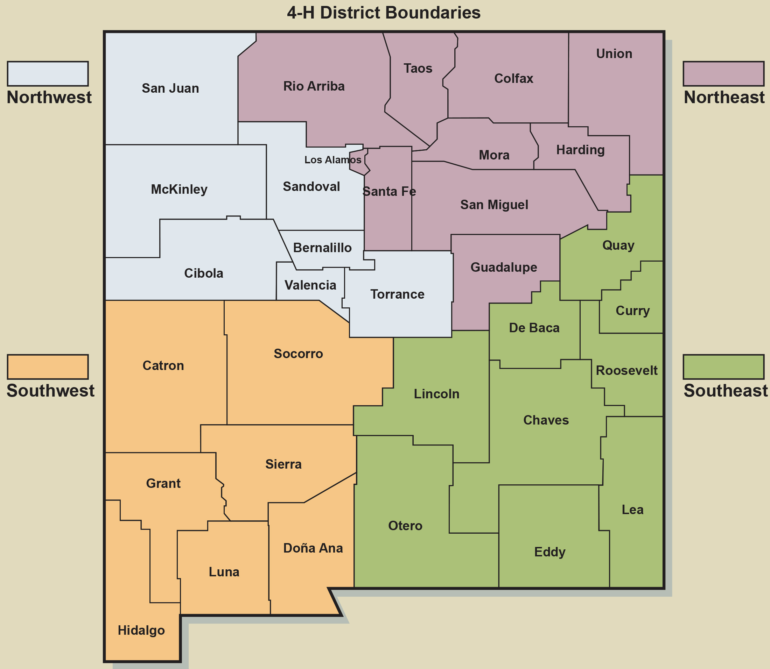
New Mexico has an office in every county
Bernalillo Catron Chaves Cibola Colfax Curry De Baca Doña Ana Eddy Grant Guadalupe Harding Hidalgo Lea Lincoln Los Alamos Luna | McKinley Mora Otero Quay Rio Arriba Roosevelt San Juan San Miguel Sandoval Santa Fe Sierra Socorro Taos Torrance Union Valencia

Slide 14
When?
Members work on their projects throughout the year then have the opportunity to exhibit completed projects at achievement days and fairs in late summer or early fall.
The 4-H year begins October 1 and runs until September 30. Enrollment begins on October 1.
Details vary by, check with your County Extension Office for details.

Slide 15
How?
A 4-H Club is an organized group approved by the county agent consisting of at least five youth from at least three different families.
Members meet regularly with adult volunteers or staff for a long-term, progressive series of educational experiences.

Slide 16
4-H Delivery Modes
Club
Special Interest
School Enrichment

Slide 17
Club
Planned program.
in school, after school, in the community or associated with a military installation.
Organized group
Educational experiences
Notes:
Script notes:
A 4-H Club is an organized group of at least five youth from at least three different families who meet regularly with adult volunteers or staff for a long-term, progressive series of educational experiences.
A club can be in school, after school, in the community or associated with a military instillation.
The club should have a planned program.

Slide 18
Leadership
Citizenship
Record books/ Portfolios
Awards/ Recognitions
Minimum Statewide Requirements
Club Meetings
Notes:
Script notes:
Basic Club Requirements by State 4-H Policy and Procedures
To assure a degree of uniformity, the following statewide club completion requirements have been established for Novice, Junior and Senior members. Each requirement pertains to the current 4-H program year. All requirements must be enforced uniformly:
The following are minimum statewide requirements for the club members in the 4-H Youth Development Program. Local clubs and county programs have the right to establish and enforce more stringent policies. Local policies must be in writing and approved by the local County 4-H Council
Club Meetings
A member must attend at least 40% of all club meetings and activities.
Leadership
A member must be involved in at least one leadership experience at the club or county level. Leadership experiences include giving a demonstration, illustrated talk or public speech; serving on a committee; serving as a club or county officer; or serving as a junior or teen leader.
Citizenship
A member must be involved in at least one citizenship activity to help others.
Record books/ Portfolios
A member may complete record sheets or portfolios in accordance with their abilities to receive a completion pin. Completion requirements are to be determined by club leaders or Extension agents in the members’ county.
Awards/ Recognitions
Awards and recognitions are determined by county.

Slide 19
Criteria for Clubs
Affirmative action guidelines.
Members are involved in determining requirements.
Requirements are filed with the County Extension Office.
Notice of new requirements.
Approved by the County Extension 4-H Agents.
No more than 50% of club or county functions.
Club secretaries' records must be kept as official documentation.
Organization take responsibility for their enforcement.
Responsibility of Members.
Notes:
Script notes:
Comply with all affirmative action guidelines.
Members are involved in determining requirements.
Requirements are incorporated into club and county by-laws, and filed with the County Extension Office. If there is a change in the club or county by-laws the revised by-laws must be filed with the county 4-H office, and a new charter must be requested by the club leader.
All members are responsible for being familiar with the club requirements.
All members must be given prior notice when membership privileges will be affected by the new requirements.
Policies must be approved by the County Extension 4-H Agents prior to implementation.
Club secretaries' records must be kept as official documentation of compliance with the requirements.
The levels, club or county, at which the requirements are established take responsibility for their enforcement.
Club or county requirements cannot require a member to be present at more than 50% of club or county functions

Slide 20
Competitions beyond the county level
District
Nationals
Grand Island, NE
Novice
Senior members
State contests include
a variety of contests held at Senior Leadership Retreat and
State 4-H Conference
Some contests have national competitions for state winners. Previous national contest sites include:
Junior
Four Districts in New Mexico
Northeast
Northwest
Southwest
Southeast
State Contest
New Mexico State 4-H Shooting Sports Championships in Raton
Oklahoma City, OK
Louisville. KY
Kansas City, MO
Denver, CO
Atlanta, GA
Notes:
Script notes:
4-H members have the opportunity to compete at different levels
District
Novice and Juniors who qualify at county may compete in District Contest.
The state of New Mexico has four districts: Northeast, Northwest, Southeast, and Southwest. Contest location will vary per district. ** Insert map that has 4-H Districts on it.
State Contest
Senior members who qualify at county may compete in state contests.
State contests include the New Mexico State 4-H Shooting Sports Championships in Raton
a variety of contests held at Senior Leadership Retreat and
State 4-H Conference.
Nationals
Some contests have national competitions for state winners. Previous national contest sites include:
Grand Island, NE
Oklahoma City, OK
Louisville. KY
Kansas City, MO
Denver, CO
Atlanta, GA

Slide 21
October- December
New 4-H Year begins
Re-enrollment for youth and adults begins
NM 4-H Adult leaders forum
January- March
NM Senior Leadership Retreat
Western National Roundup
Home Ec School
State 4-H Youth Leadership Summit
4-H Day at the Roundhouse
April-June
Youth Get Away
Enrollment Deadlines
Horse Certificates due
National, State, and District Shooting Sports
Horse and Livestock Schools
District Contest
4-H Rodeo begins
July- September
State Conference
County and State Fairs
Check with your county for details.
Notes:
Calendar Overview- broken down into quarters beginning in October, the start of the new 4-H year.

Slide 22
Special Interest
In order to meet the requirements of 4-H Special Interest programming, the following criteria is established:
1. Participating youth are 4-H members and will be enrolled through the 4-H computer enrollment system.
2. A minimum of six contact hours
3. The program must consist of planned educational objectives that can be evaluated..
Notes:
Script notes:
In order to meet the requirements of 4-H Special Interest programming, the following criteria is established:
1. Every effort must be made by the participating adults to help youths understand from the outset that they are participating in a 4-H program. Participating youth are 4-H members and will be enrolled through the 4-H computer enrollment system.
2. A minimum of six contact hours must be made with the youth audience.
3. The program must consist of planned educational objectives that can be evaluated. A planned follow-up is recommended to encourage youth to take advantage of additional 4-H opportunities within the 4-H youth development program.

Slide 23
School Enrichment
School administration and the classroom teacher
Subject matter topic
Adult leadership
Notes:
Script notes:
4- H School Enrichment groups can be established if school administration and the classroom teacher are supportive.
The group focuses on a subject matter topic. Topics can include any of those projects pursued by club members, in addition to those specifically designed for shorter term involvement.
Adult leadership can be provided by the classroom teacher, county extension agent, teen and adult volunteers, other community volunteers or a combination of these individuals.

Slide 24
More likely to give back to their communities
More likely to make healthier choices
More likely to participate in STEM activities
More likely to be civically active
More likely to participate in science activities outside of school time
4X
2X
2X
2X
2X
The Positive Development of Youth: Comprehensive Findings From the 4-H Study of Positive Youth Development. Richard M. Lerner, Jacqueline V. Lerner and Colleagues. Institute for Applied Research in Youth Development. Tuffs University. 2002-2010
Notes:
Script notes:
4-H has a unique hands-on approach that gives youth the opportunity to learn by doing and build life skills.
4-Hers are:
More likely to give back to their communities
More likely to make healthier choices
More likely to participate in STEM activities
More likely to be civically active
More likely to participate in science activities outside of school time

Slide 25
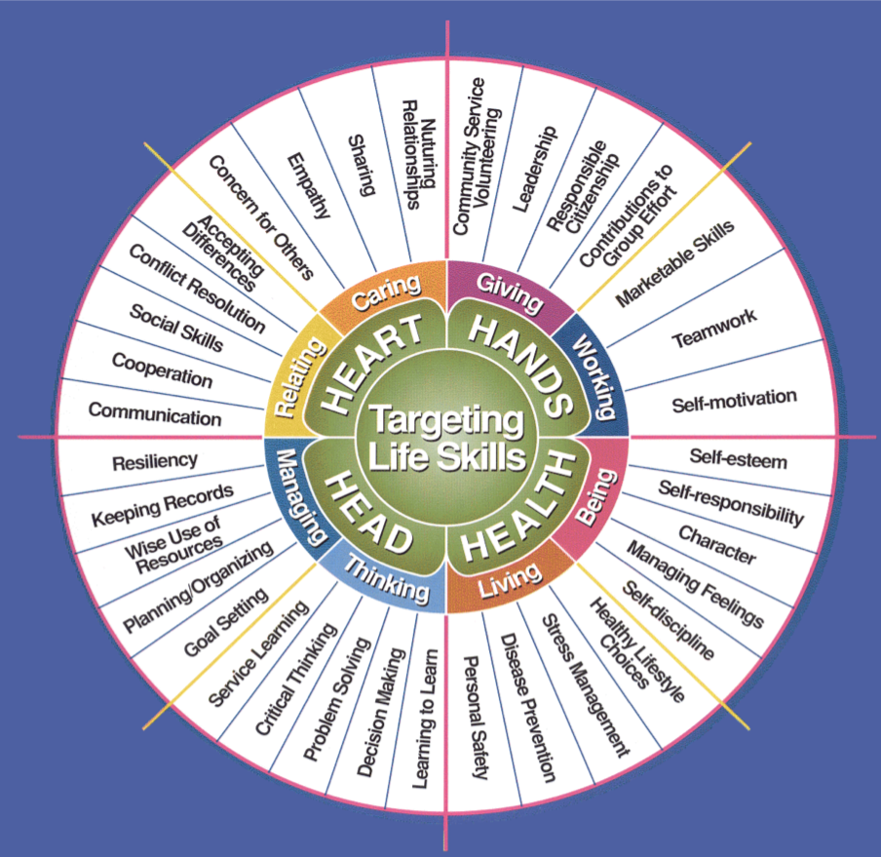

Slide 26
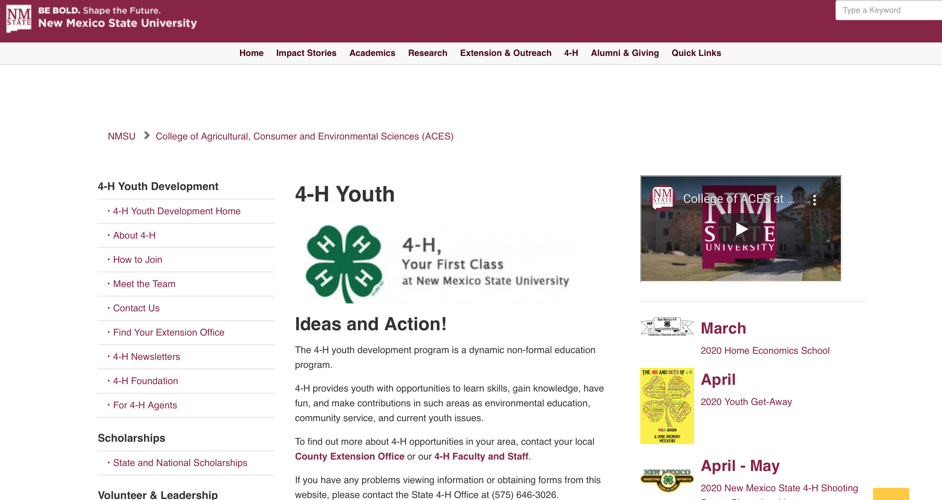
For more information about 4-H in your county go to the New Mexico 4-H website. The menu on the left side of that page has a Find Your Extension Office tab.

